Slide 1
Morris County Municipal Utilities Authority
Municipal Recycling Coordinators Meeting
September 22, 2020
Today’s meeting will meet the MTG requirement and will count as 1.5 classroom credits for CPR recertification.

Slide 2
$12 million dollars to be diverted from Recycling money!
ANJR requests that you reach out to the state legislature:
(LBFO@njleg.org) on the proposed 2020 state budget, which may divert $12 million from the Recycling Fund to Parks Management.
Please email and send letters to local state legislators expressing your concern about the negative impact this will have on recycling programs!
Questions: Call Marie Kruzan (ANJR), at 908-722-7575 or email: anjr@optimum.net
Senator Anthony Bucco:
abucco@murphymckeonlaw.com

Slide 3
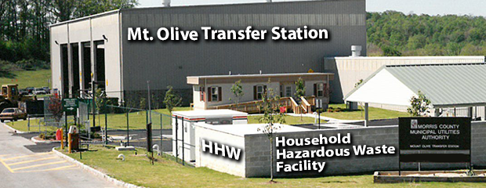
MCMUA Household Hazardous Waste Program
Hazardous Waste Disposal!

Slide 4
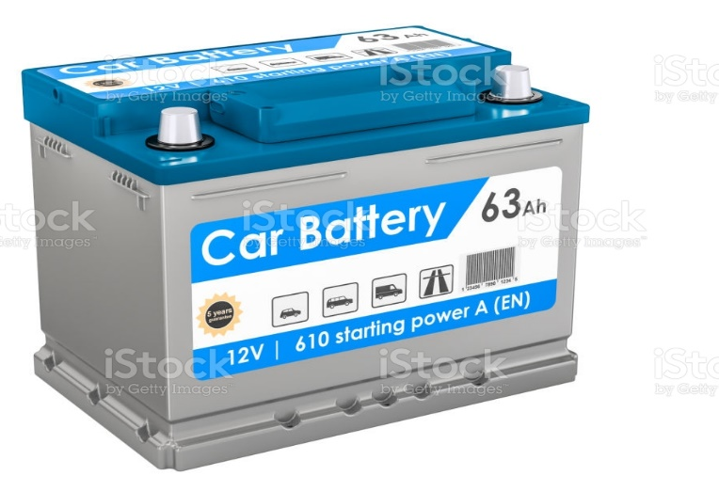
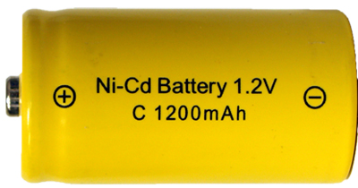
The MCMUA Household Hazardous Waste Department operates a permanent facility for disposal of hazardous waste and e-waste. Residents and small businesses have an outlet for the proper management of their hazardous materials. Access to the permanent facility is by appointment only!

Slide 5
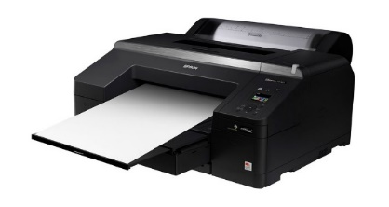
Computers
Monitors
Tablets
Laptops
Desktop printers & faxes
Televisions
Don’t put electronics into the trash!

Slide 6
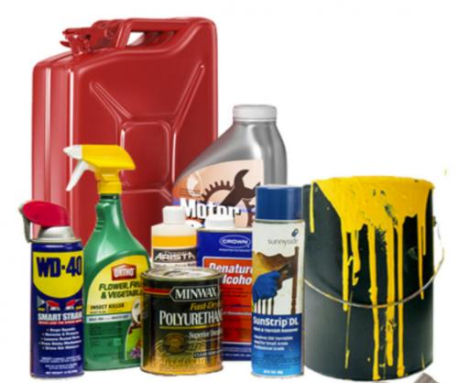
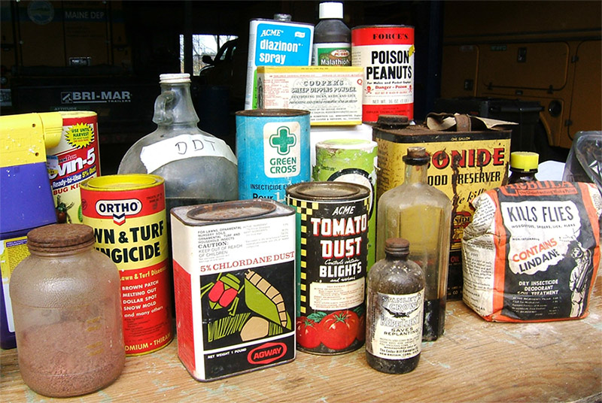
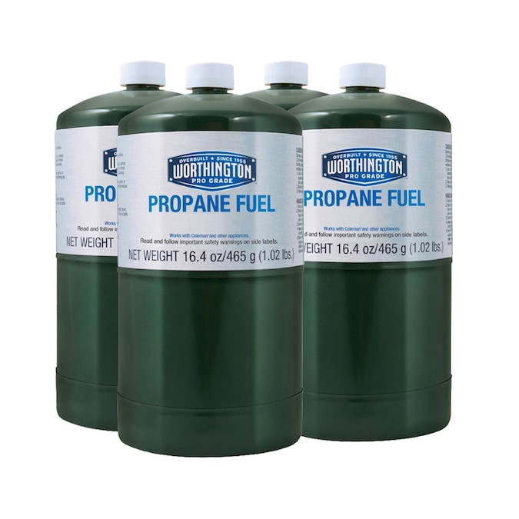
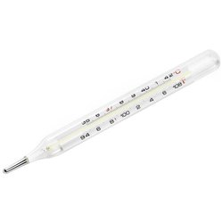
More Acceptable Materials
Mercury thermometers/devices

Slide 7
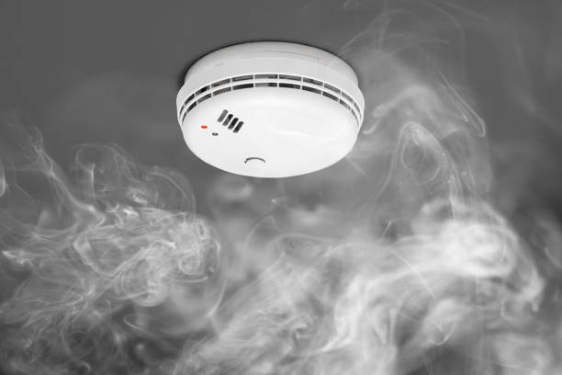
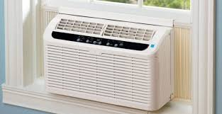
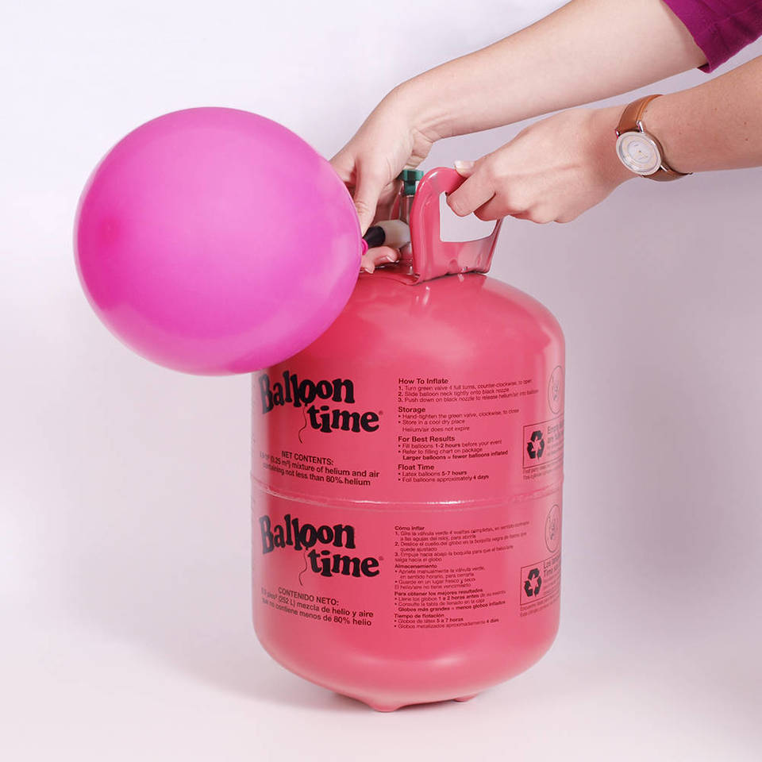
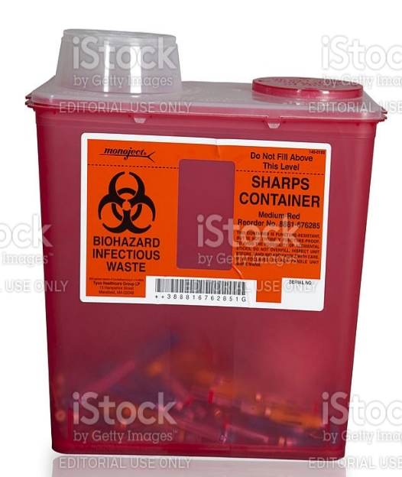
Unacceptable
Smoke detectors
Any items containing Freon
Sharps
Helium tanks

Slide 8
Recertification Credit Information
Carol M. Broccoli
Office of Continuing Professional Education
NJ Agricultural Experiment Station/Rutgers Cooperative Extension
Rutgers University
102 Ryders Lane
New Brunswick, NJ 08901-8519
(848) 932-7207
(732) 932-1187 (fax)
E-mail: carolbr@njaes.rutgers.edu
Website: www.cpe.rutgers.edu

Slide 9
Thank you to our Guest Speakers:
Eric Gabrielson
Morris Recycling Operations Manager
e: egabrielson@republicservices.com
o: 862.473.0638 c: 973.580.5858

Slide 10
Thank you!
Stay Safe and Be Well!

