Slide 1
Haz Mats – Recycling - Pandemics
This wasn’t in the brochure!!!
September 22, 2020

Slide 2
Flammables – Combustibles – Haz Mats
Major sources of Fires
Batteries
Electronic devices
Camping propane
Ethanol Free & Fuel:Oil mixes
Blowtorch tanks
Paint products
Different items cause fire hazards throughout the facility and beyond.

Slide 3
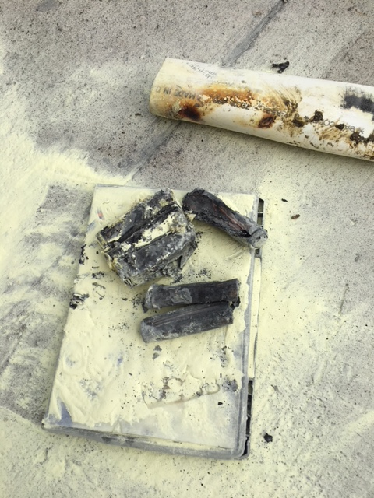
Batteries – Perhaps our worst enemy
Bale fire - Cordless tool battery?
Found after baler ejected bale. Sprayed immediately. Remained smoking until repeated dousing with water.

Slide 4
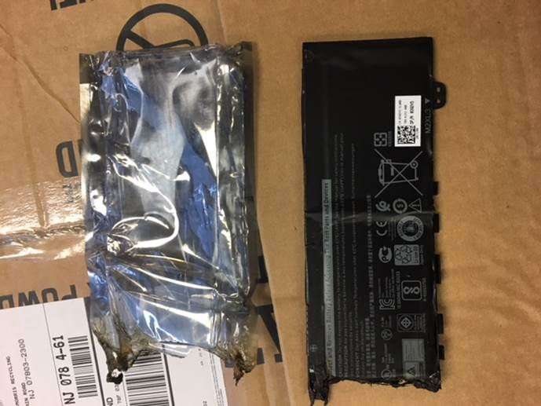
Fire in presort station
Laptop Battery
Spotted on incline belt by loader – extinguished by presort personnel.
Lifesaving communication!!

Slide 5
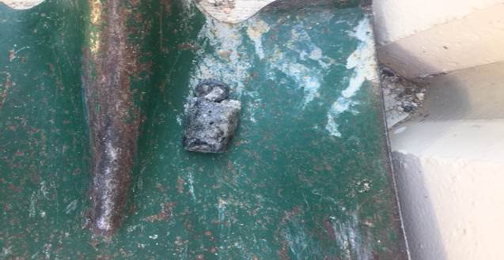
Tip Floor Fire
Small – Lithium Ion?
Flammable – Combustible – Haz Mat
Flammable – Combustible – Haz Mat
Removed from tip floor by wheel loader – extinguished immediately

Slide 6
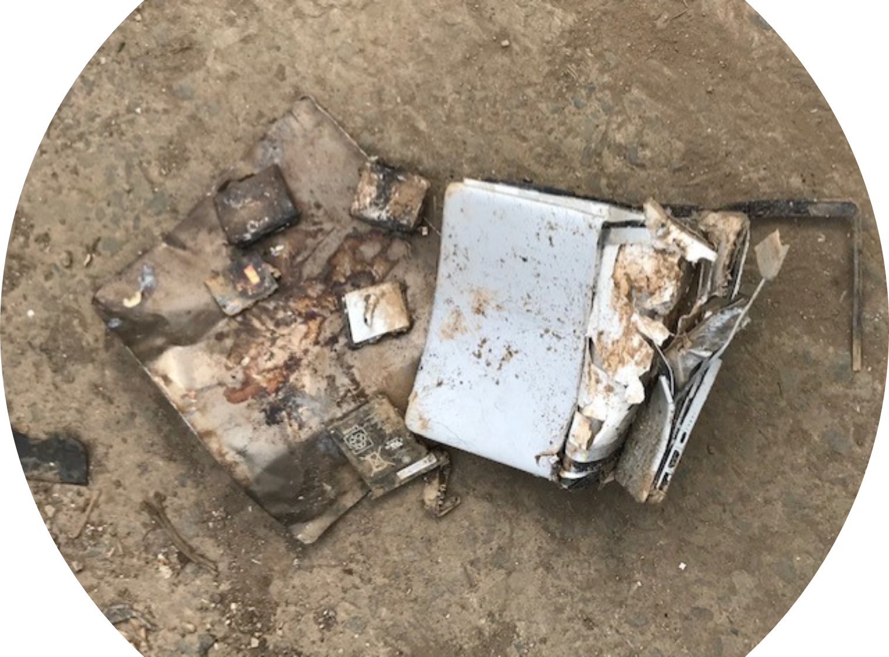
Electronic device
Passed through our system
Flammable – Combustible – Haz Mat
Flammable – Combustible – Haz Mat
Ignited at our scrap metal recyclers facility

Slide 7
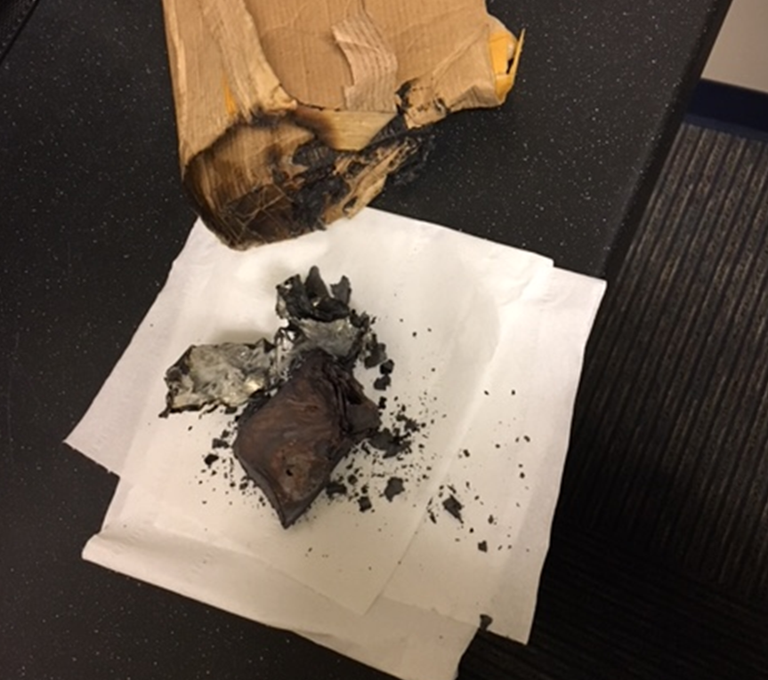
Old hand warmer
Chemical reaction
t
Removed from tip floor by wheel loader – extinguished immediately

Slide 8
Tip Floor Fire
Small – Lithium Ion?
Flammable – Combustible – Haz Mat
Flammable – Combustible – Haz Mat
Removed from tip floor by wheel loader – extinguished immediately

Slide 9
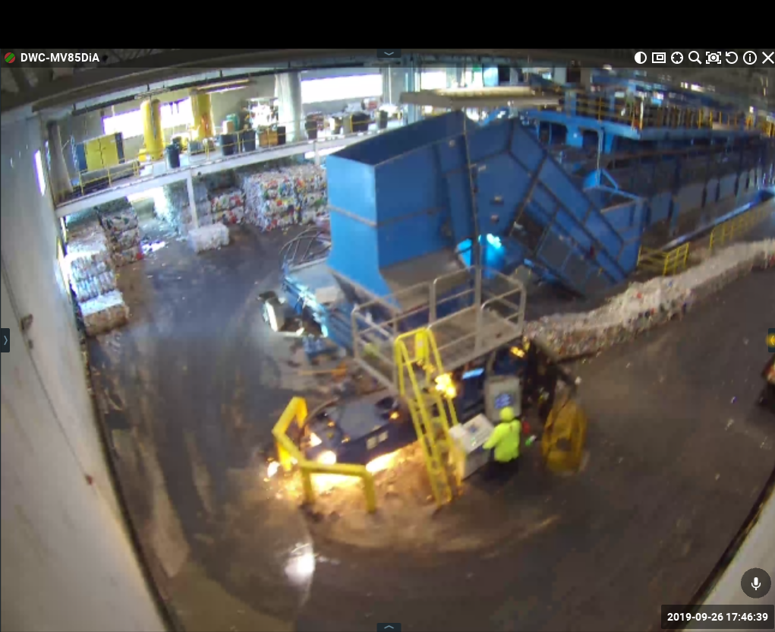
Tin Baling Operation
Highest Frequency of fires in Mine Hill
Significant reduction in fires from 2019 to2020

Slide 10
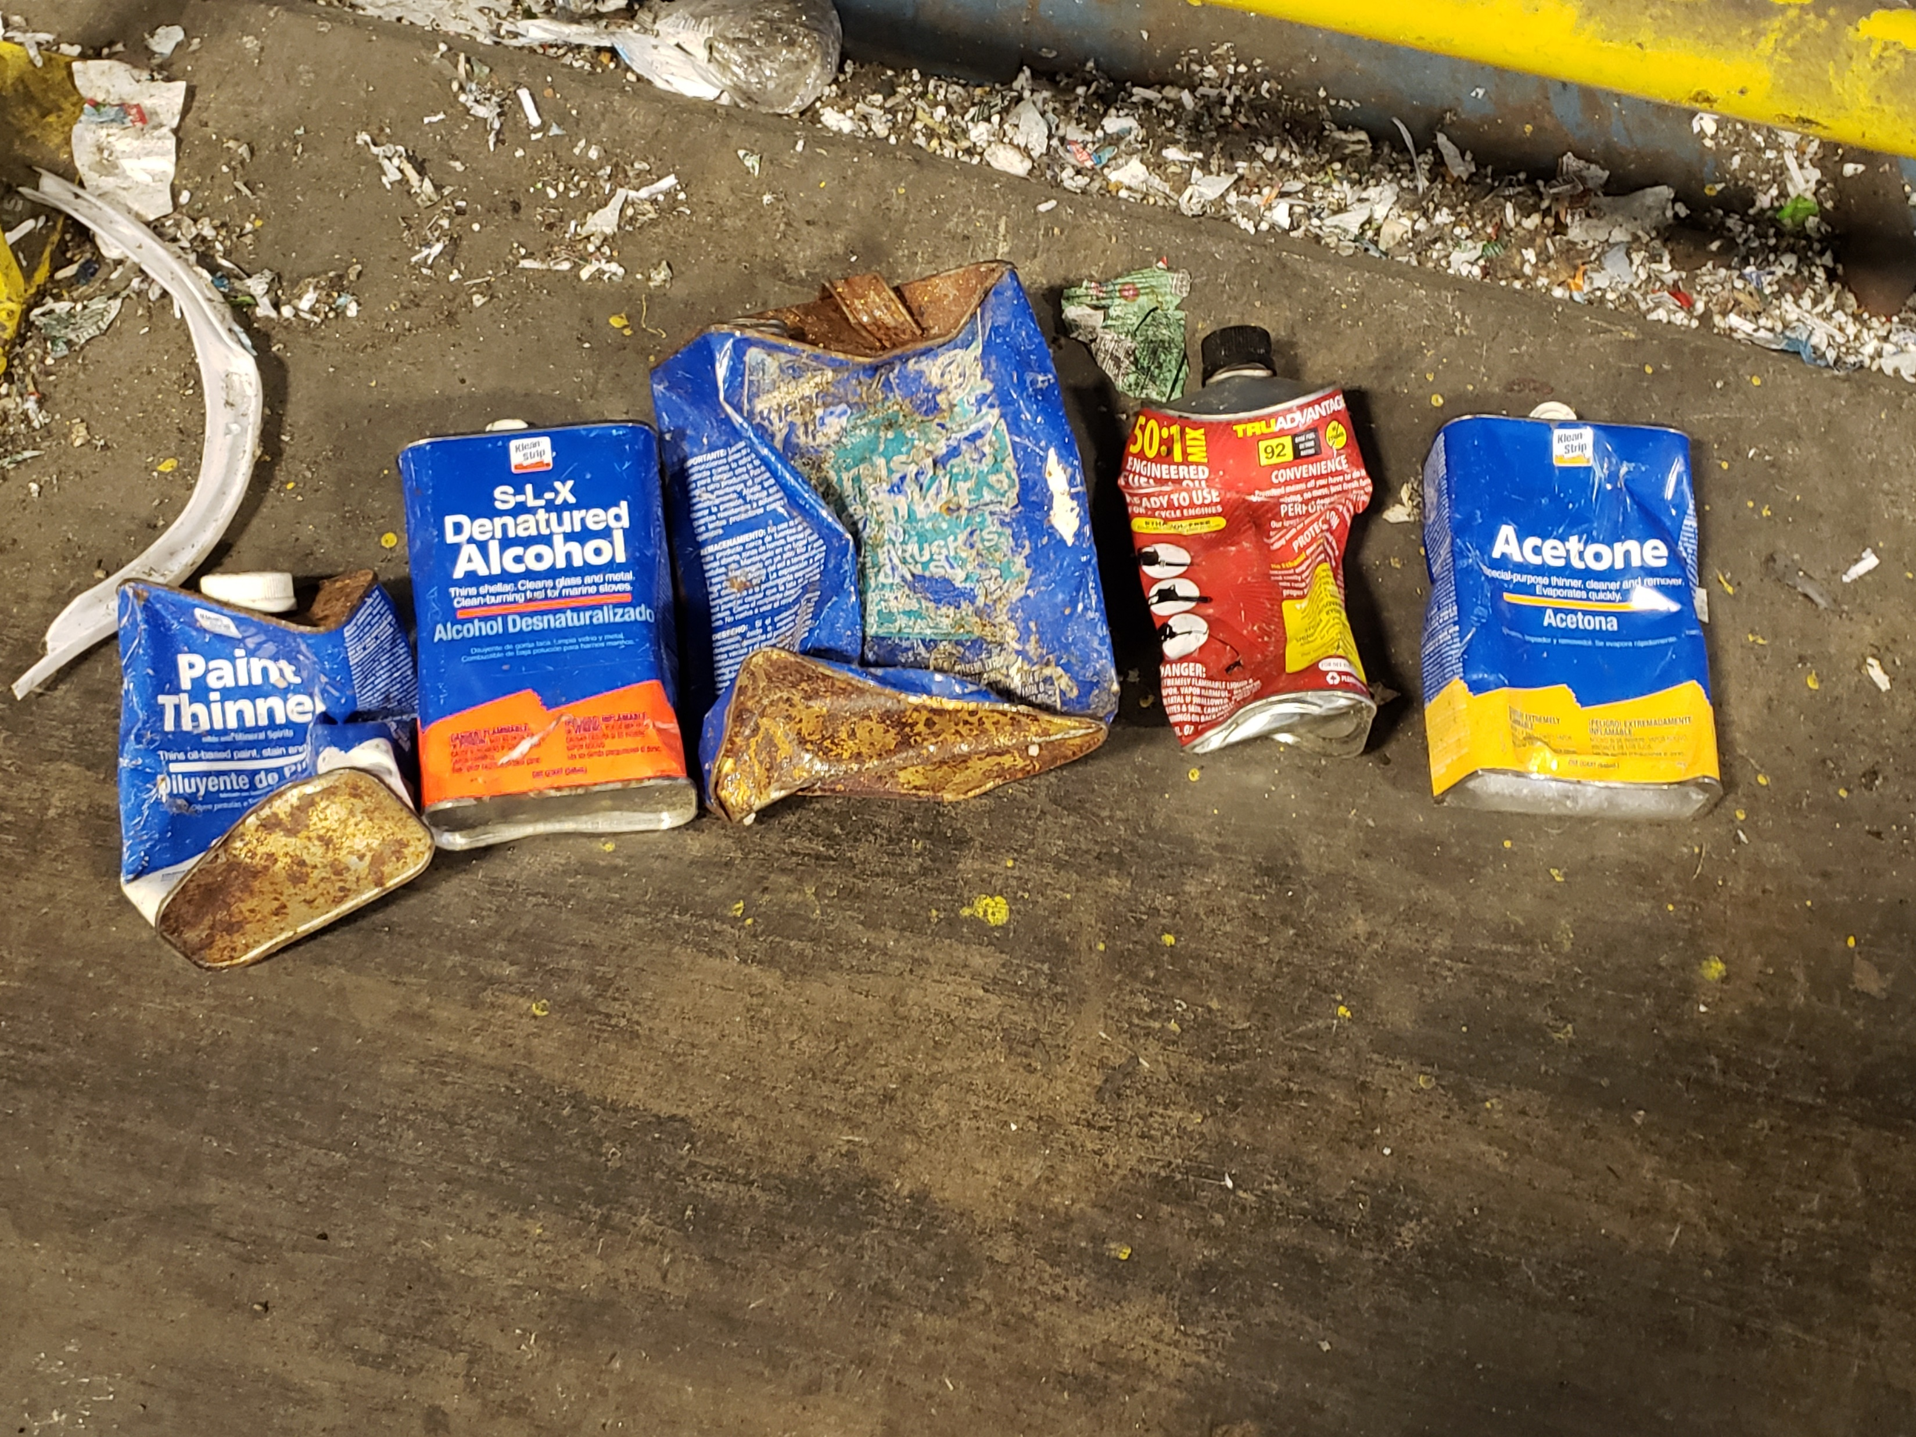
Baler Fire Prevention
Removed during Tin baling
Manually removed from baler infeed.

Slide 11
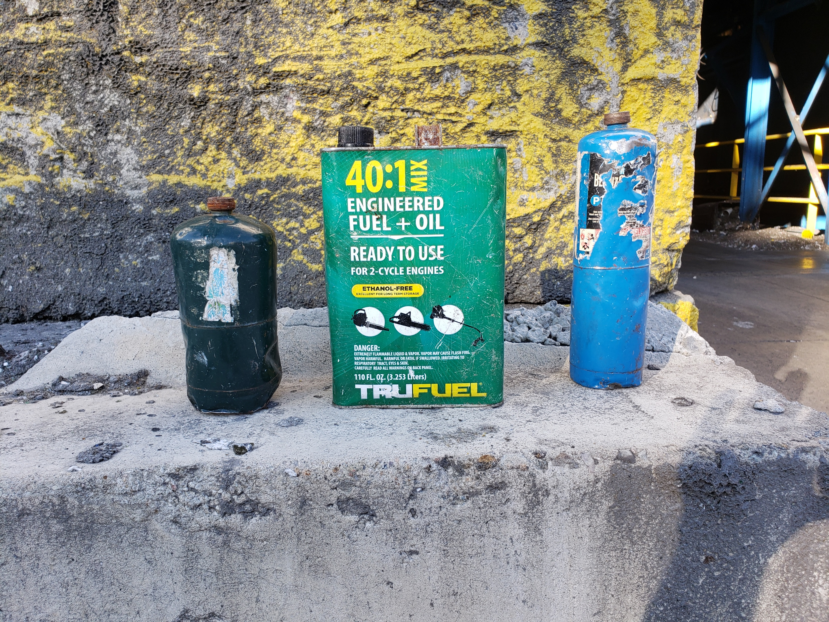
Baler Fire Prevention
Removed during Tin baling
Manually removed from baler infeed.

Slide 12
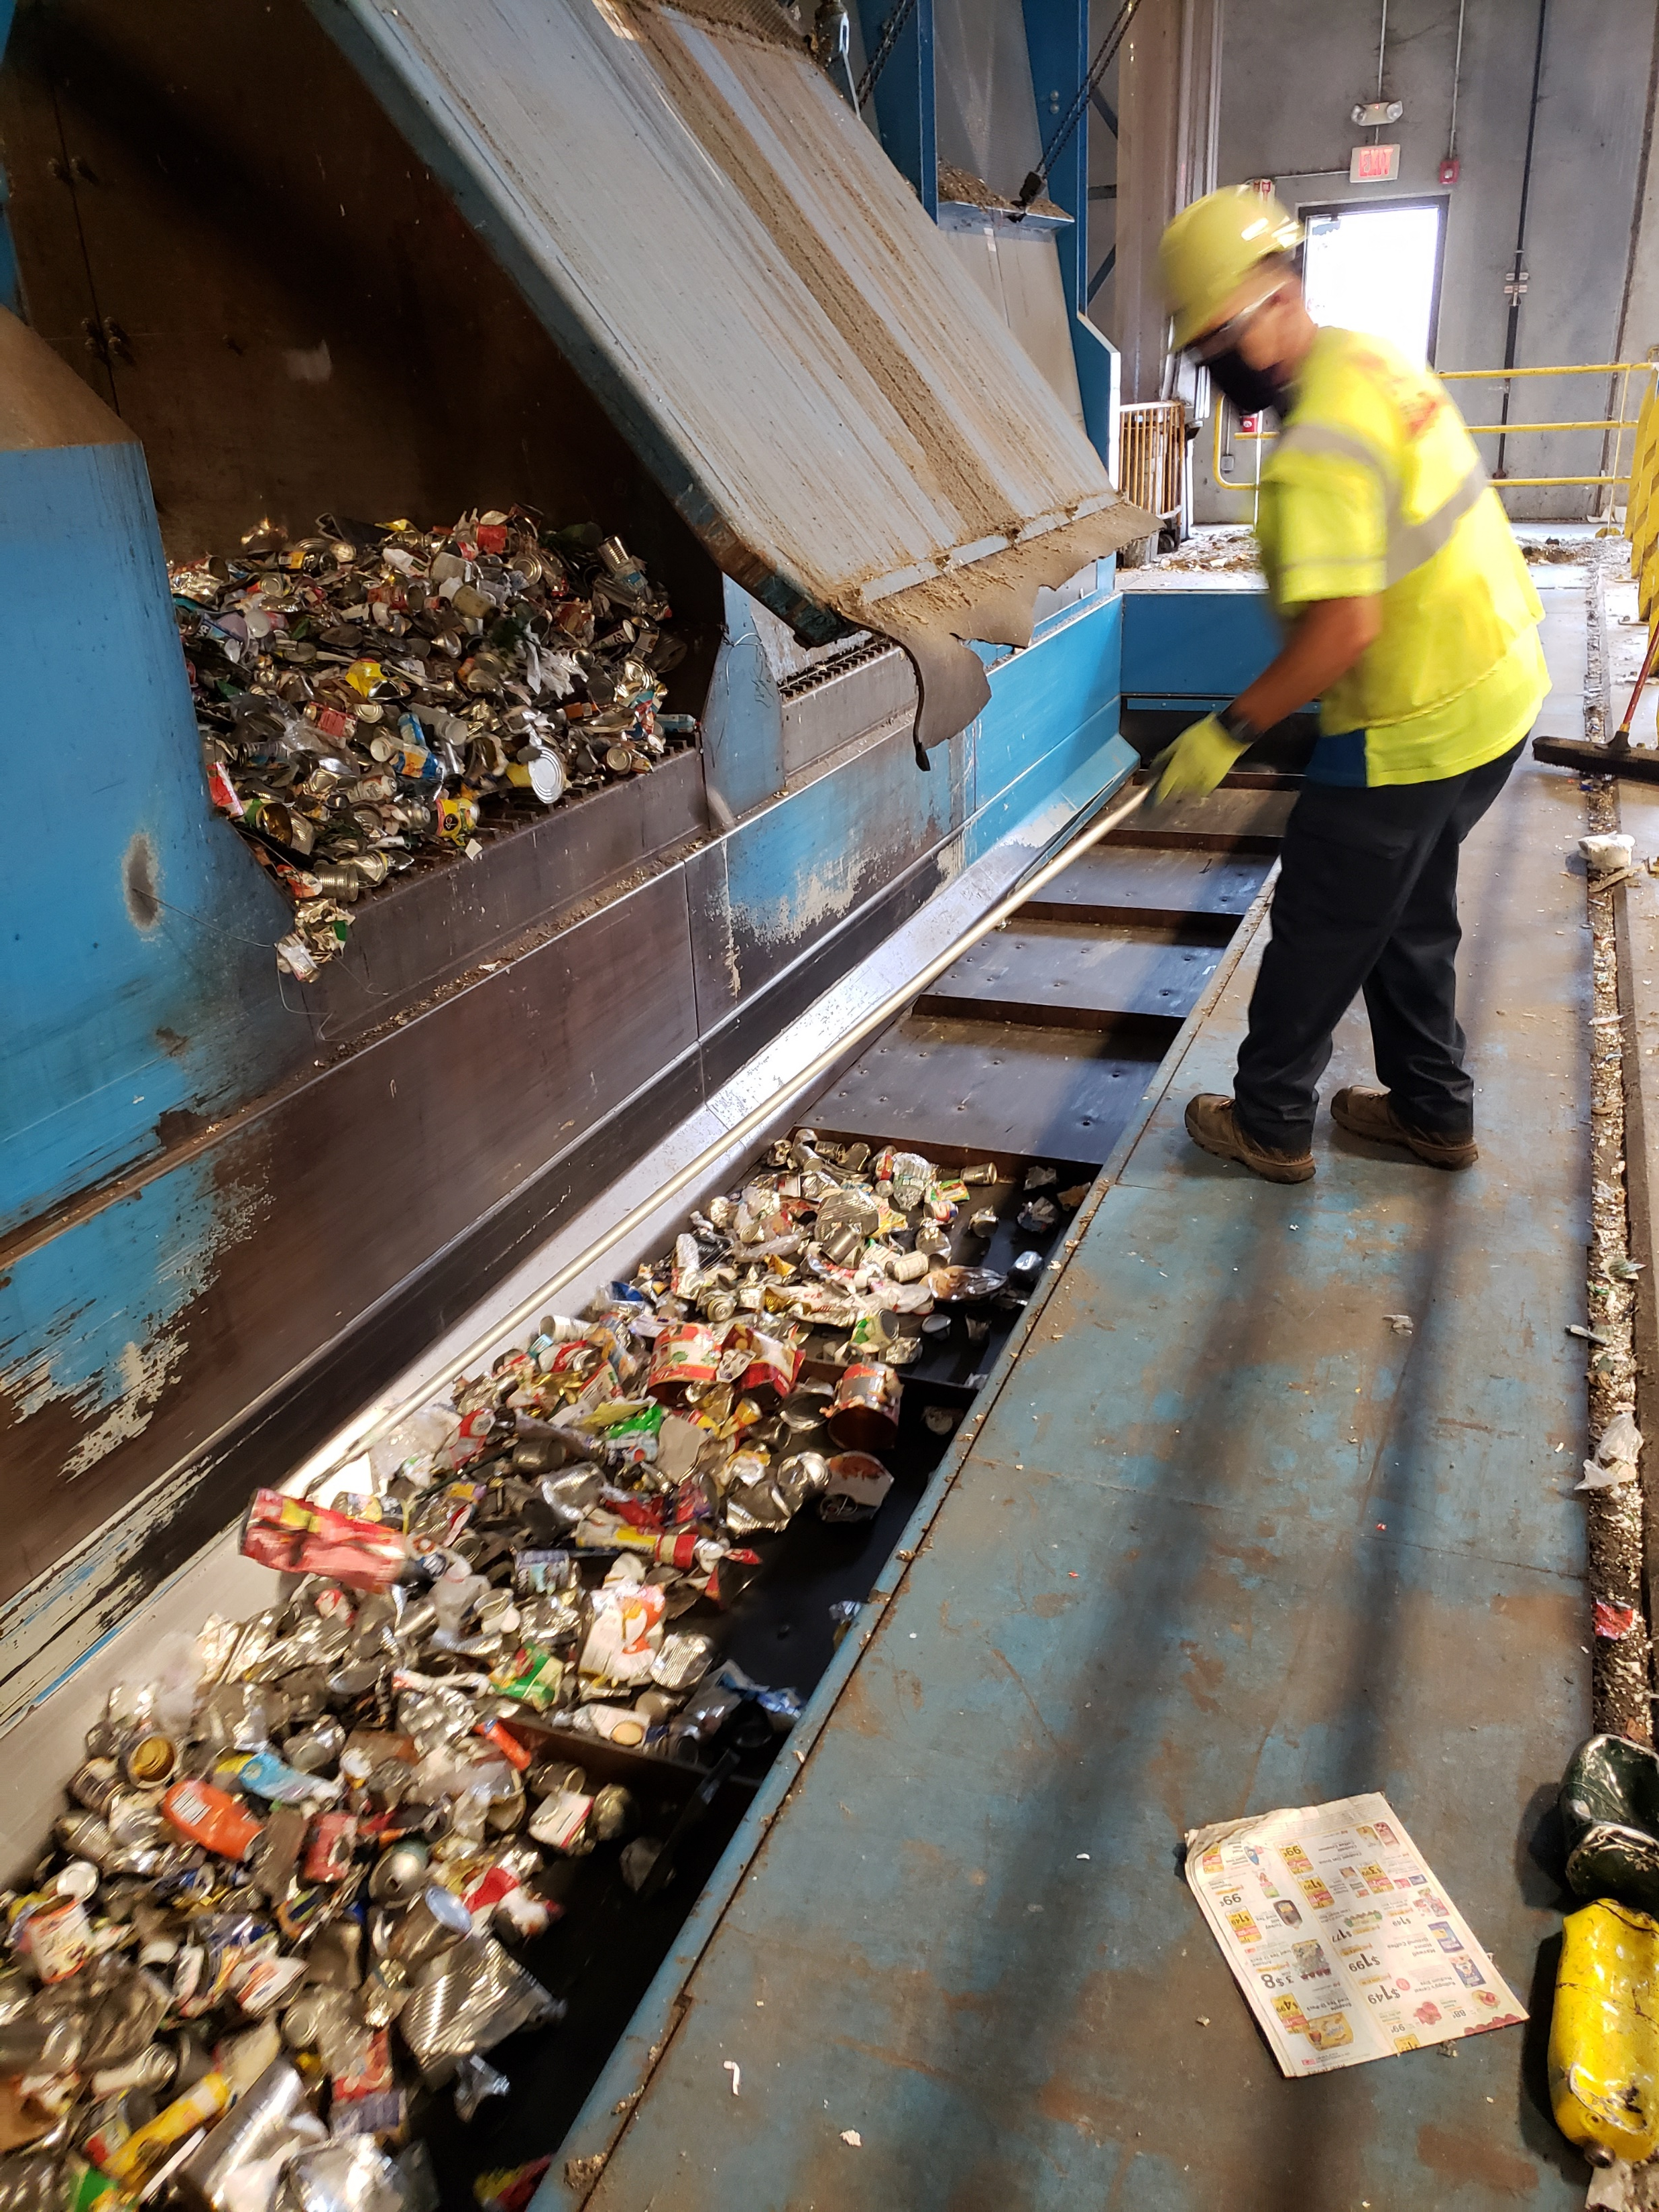
Added layer of QC
New measure begun in June 2020
Will review effectiveness in 4th quarter. Present outcomes of efforts have shown improvement.

Slide 13
Impact to a MRF (and our partners)
Negative outcomes from unwanted items:
Safety issues – Fires
Elevated residual costs
Plant Downtime due to damaged equipment

Slide 14

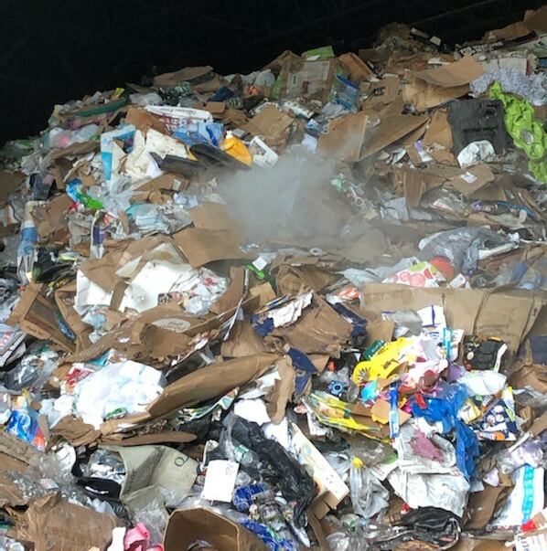

Slide 15
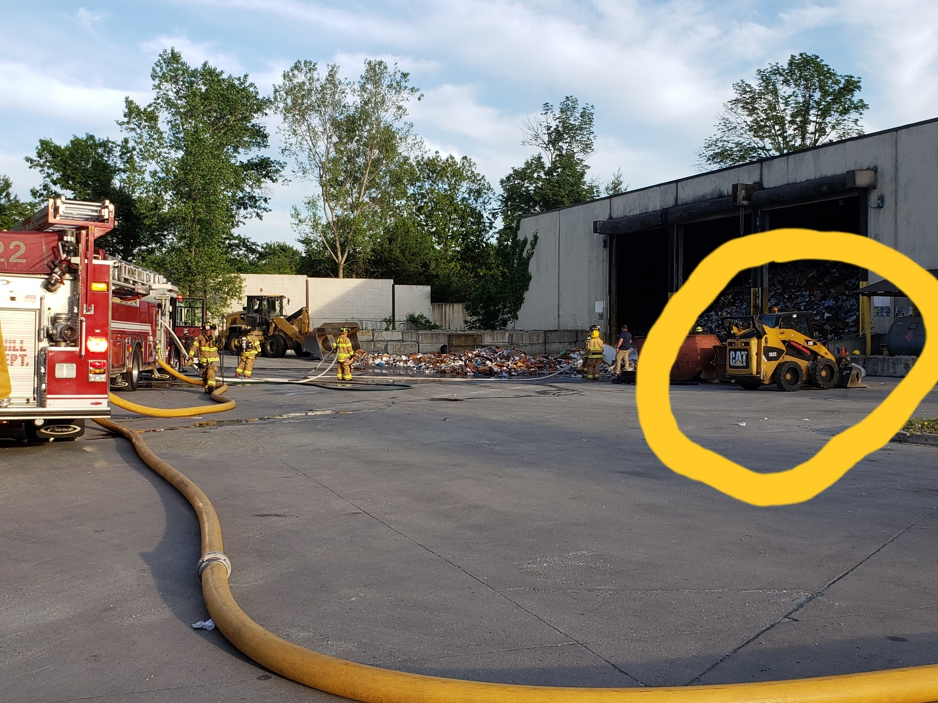

Slide 16
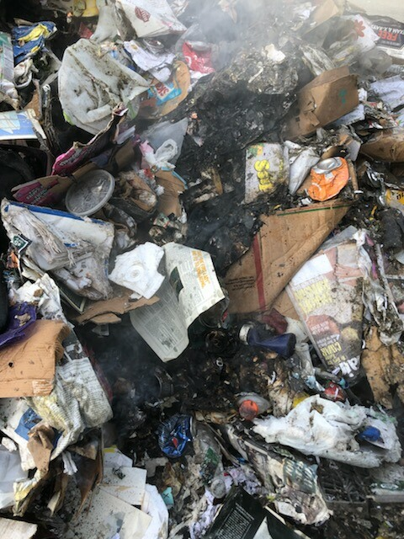

Slide 17
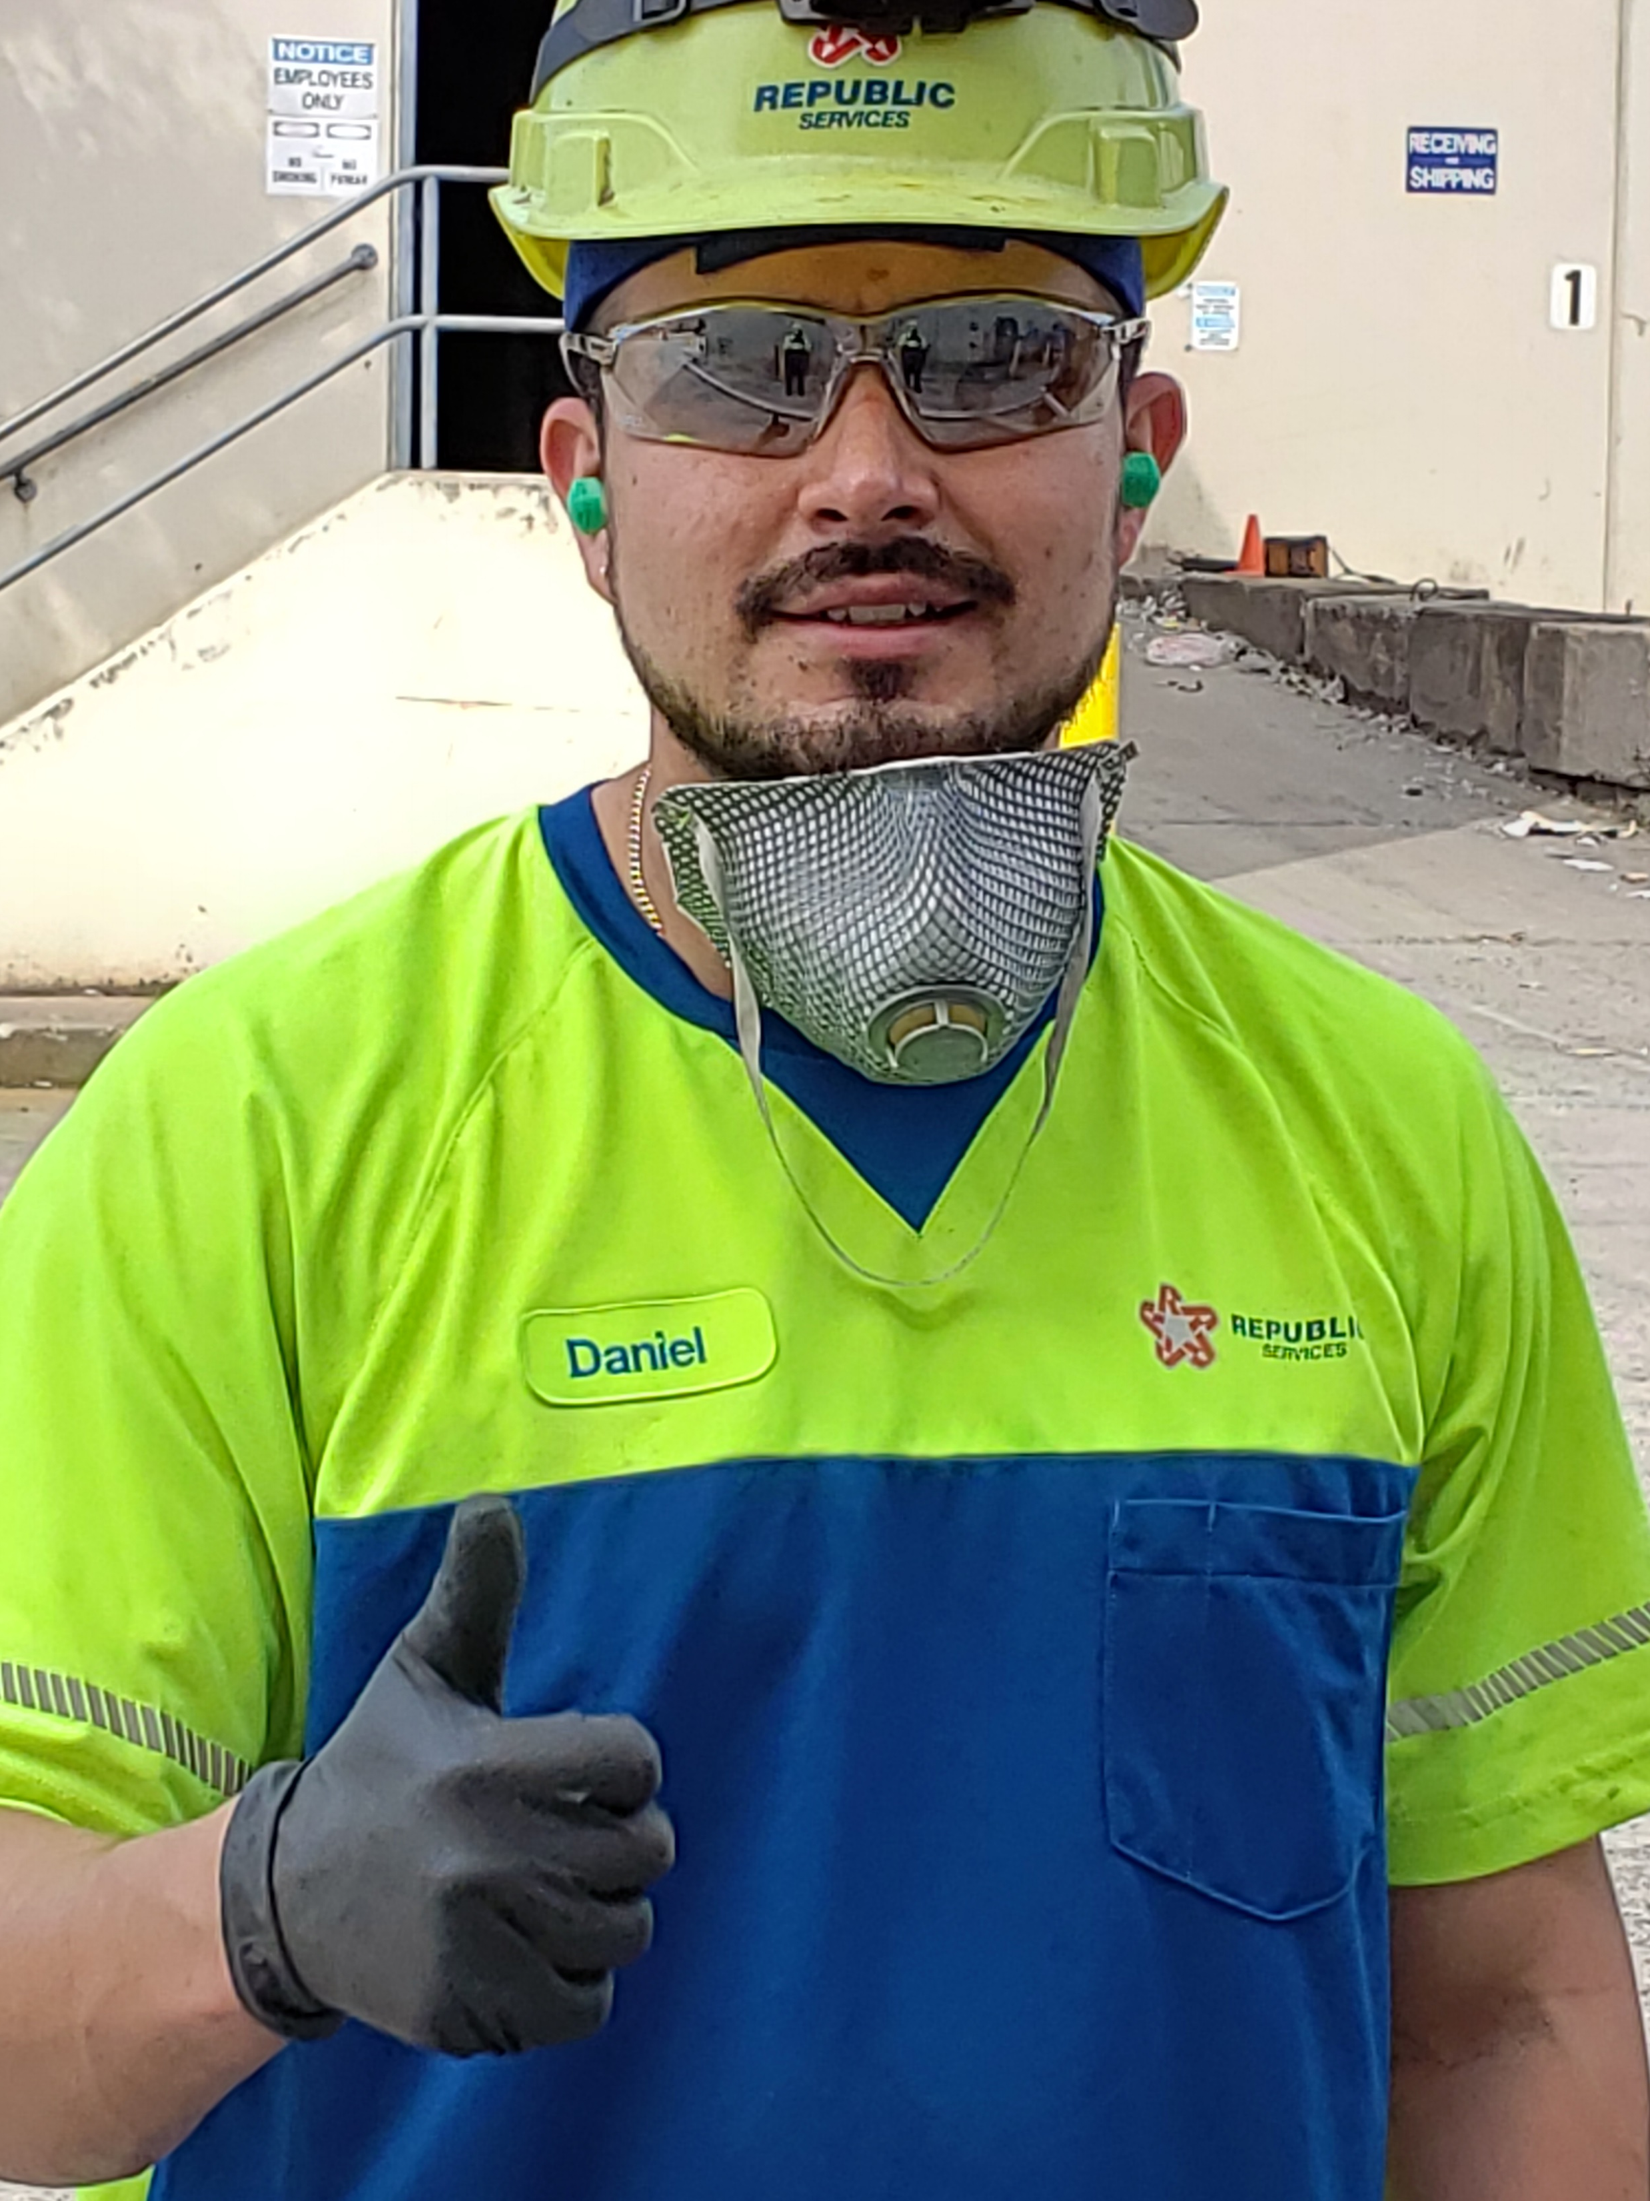
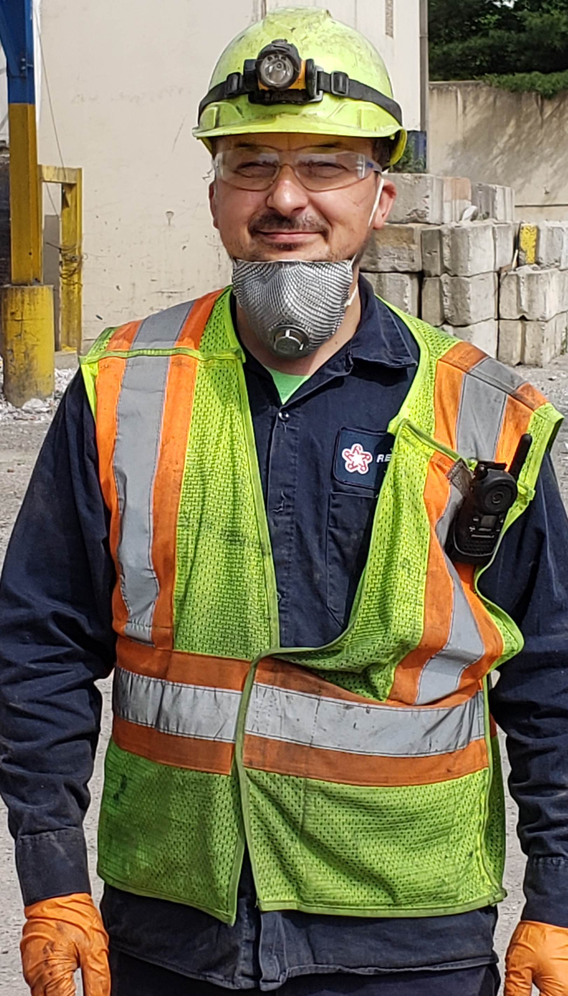
The Heroes!
The right guys in the right place at the right time!!!
Andy Zachwieja and Daniel Jaramillo

Slide 18

Handling Dangerous Items
Search on tipping floor
Educate pre-sort (and everywhere else)
2 man watch on baler belt

Slide 19
2020 in review … “A year unlike any other”
No shortage of new challenges!!!!
January export stoppage
Onset of world pandemic
Working through exposure
Stay at home – rapidly evolving tons
Composition issues – OCC havoc
Tonnage fluctuations
Trucking issues growing
Best operating year since before 2018

Slide 20

Eric Gabrielson
Operations Manager
e: egabrielson@republicservices.com
o: 862.473.0638 c: 973.580.5858

